Slide 1


BLUESUN 1WM/2MWH
ENERGY STORAGE SYSTEM

Slide 2
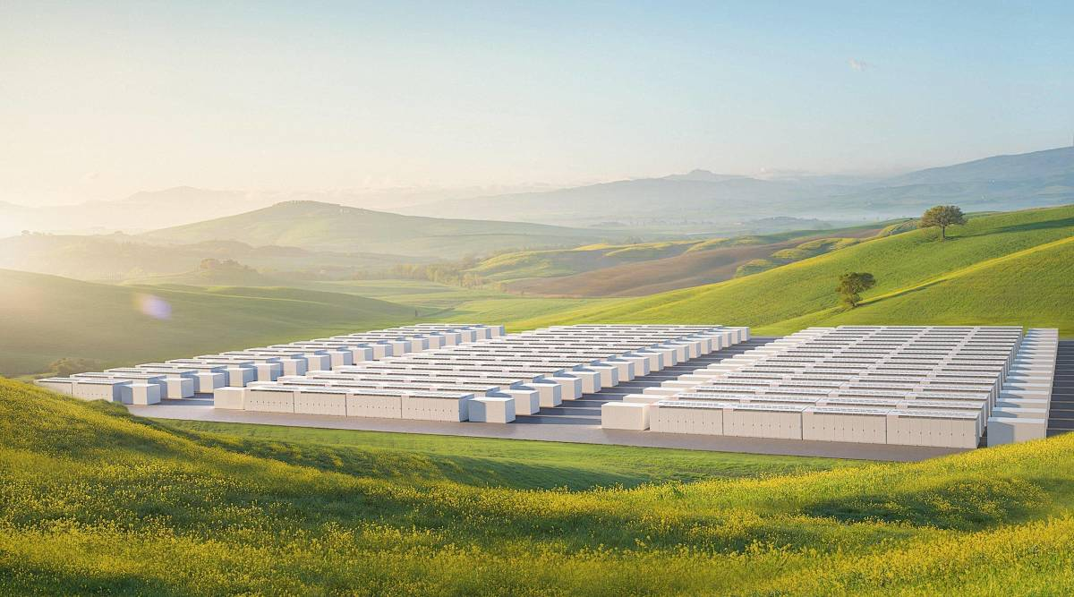




01
CHAPTER
Mission
Enable green energy to create a zero-carbon ecology
Vision
To become a world-class leader in energy technology innovation
Value
Adhere to the right innovation practice and smooth
Technical Proposal
02
Product Sepcification
03
2
System function
全球布局

Slide 3




01 System Configure
1MW/2MWh
400V
The system application scenario is solar energy storage system self-using.
The requirement for the battery system is 1 MW 2 MWh available.
The system will output 400 V AC voltage.
For this system, we provide the a all-in-one Liquid cooling battery as proposal.
Initial Configuration
PV power | 1MW
Energy storage system | 2MWH
AC power output | 1MW

Slide 4
01 Main device List
Specification |  | Qty | Unit | Item
PV panel 610W solar panel | Half cell topcon | 1638 | piecess
DC combiner box | 12 lines in and 12 lines out | 8 | pieces
Solar panel rack |  | 1 | set
ON-grid string inverter 125KW |  | 8 | pieces
125KW/261KWH energy storage system cabinet | 166.4V 314AH lithium battery moudle including BMS | 5 | pieces
 | High voltage control box | 1 | piece
 | Liquid cooling machine | 1 | piece
 | 125KW PCS | 1 | piece
 | Fire protection system | 1 | set

Slide 5
01 Degradation Table
BATTERY SIZING CALCULATION AND CAPACITY PROFILE FOR 10YEARS (FOR 1 MW / 2.08MWh BESS)
Year | Designed Gross Battery Capacity | Degradation for 1 Cycle/day) | AC Output Efficiency | Total AC Usable Cap.(MWh)
Year 0 | 2.08 | 98.40% | 85.06% | 1.77
Year 1 | 2.08 | 92.01% | 83.05% | 1.72
Year 2 | 2.08 | 88.03% | 82.26% | 1.71
Year 3 | 2.08 | 85.32% | 81.57% | 1.69
Year 4 | 2.08 | 84.06% | 80.95% | 1.68
Year 5 | 2.08 | 82.75% | 80.35% | 1.67
Year 6 | 2.08 | 81.57% | 79.78% | 1.66
Year 7 | 2.08 | 80.35% | 79.22% | 1.64
Year 8 | 2.08 | 79.13% | 78.66% | 1.63
Year 9 | 2.08 | 77.91% | 78.12% | 1.62
Year 10 | 2.08 | 76.69% | 77.57% | 1.61
300⁺
Projects completed
15⁺GWh
Deployed
18⁺million
Cells analyzed
0
Safety issues
3

Slide 6
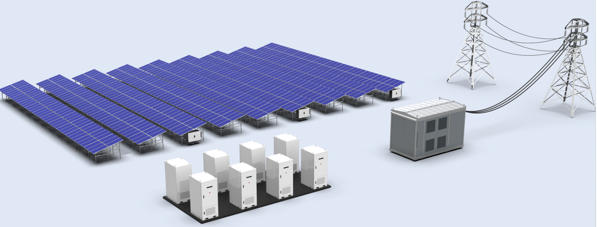

01 Installation oversee

Slide 7
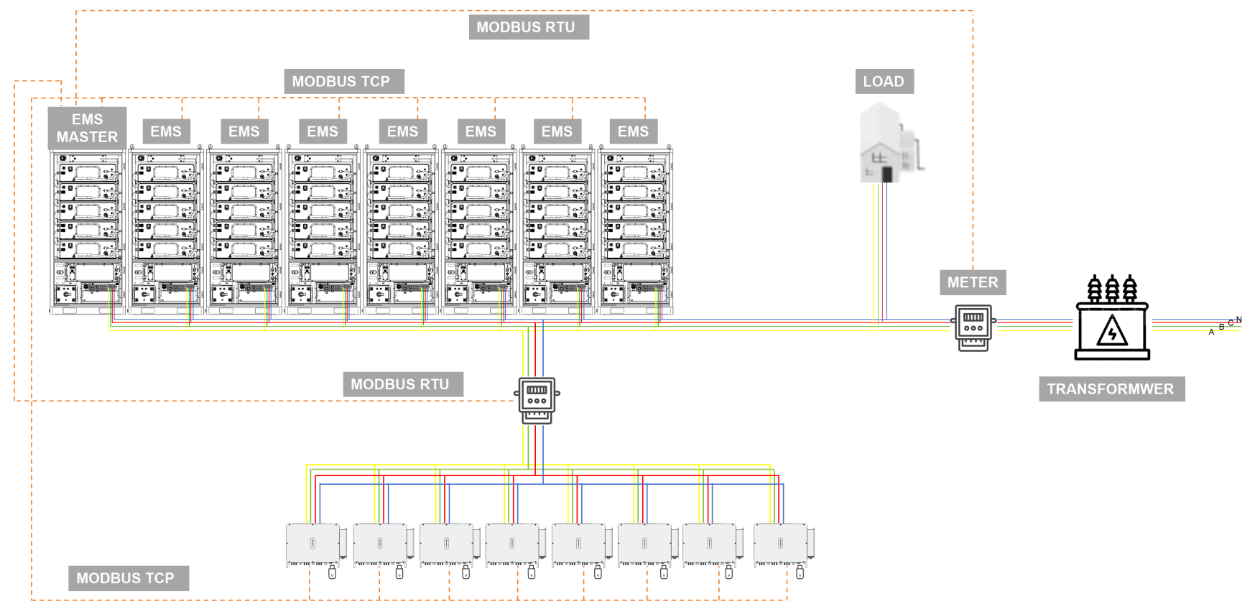
01 Schematic diagram

Slide 8
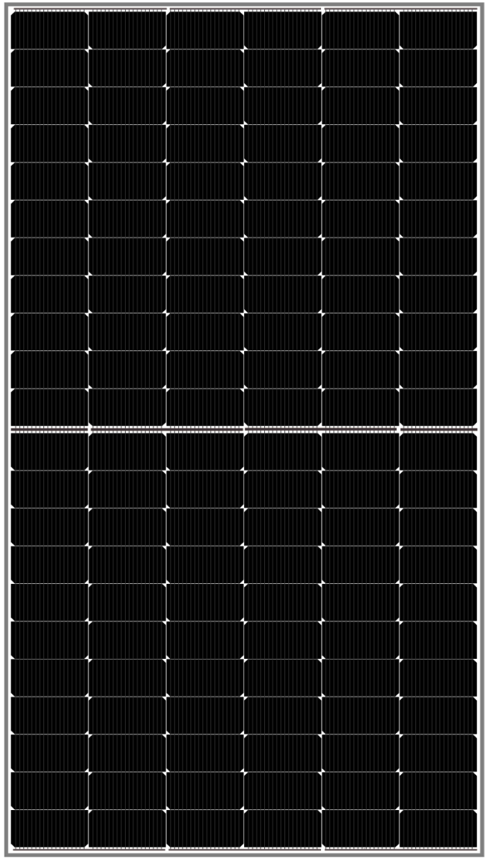
02 PV panel
Module Type | BSM610M10-78HNH
Maximum Power(Pmax/W) | STC | NMOT
 | 610 | 461
Operating Voltage | 50.34 | 48.05
Operating Current (Imp/A) | 15.47 | 12.50
Open-Circuit Voltage (Voc/V) | 41.58 | 39.02
Short-Circuit Current (Isc/A) | 14.66 | 11.83
Moudle Efficiency ηm(%) | 23.61
Power Gain | 5%
Maximum Power (Pmax/W) | 641
Module Efficiency(η/%) | 24.79
Power Gain | 15%
Maximum Power (Pmax/W) | 671
Module Efficiency(η/%) | 25.98
Cell Type | N-type Topcon
Cell Arrangement | 132(6*22)
Weight | 32.5kg
Module Dimensions | 2278*1134*30mm
Maximum System Voltage | 1500V DC(IEC)
Operating Temperature | -40°C~ +85°C
Maximum Series Fuse | 30A
Static Loading | Snow Loading: 5400Pa/ Wind Loading: 2400Pa

Slide 9
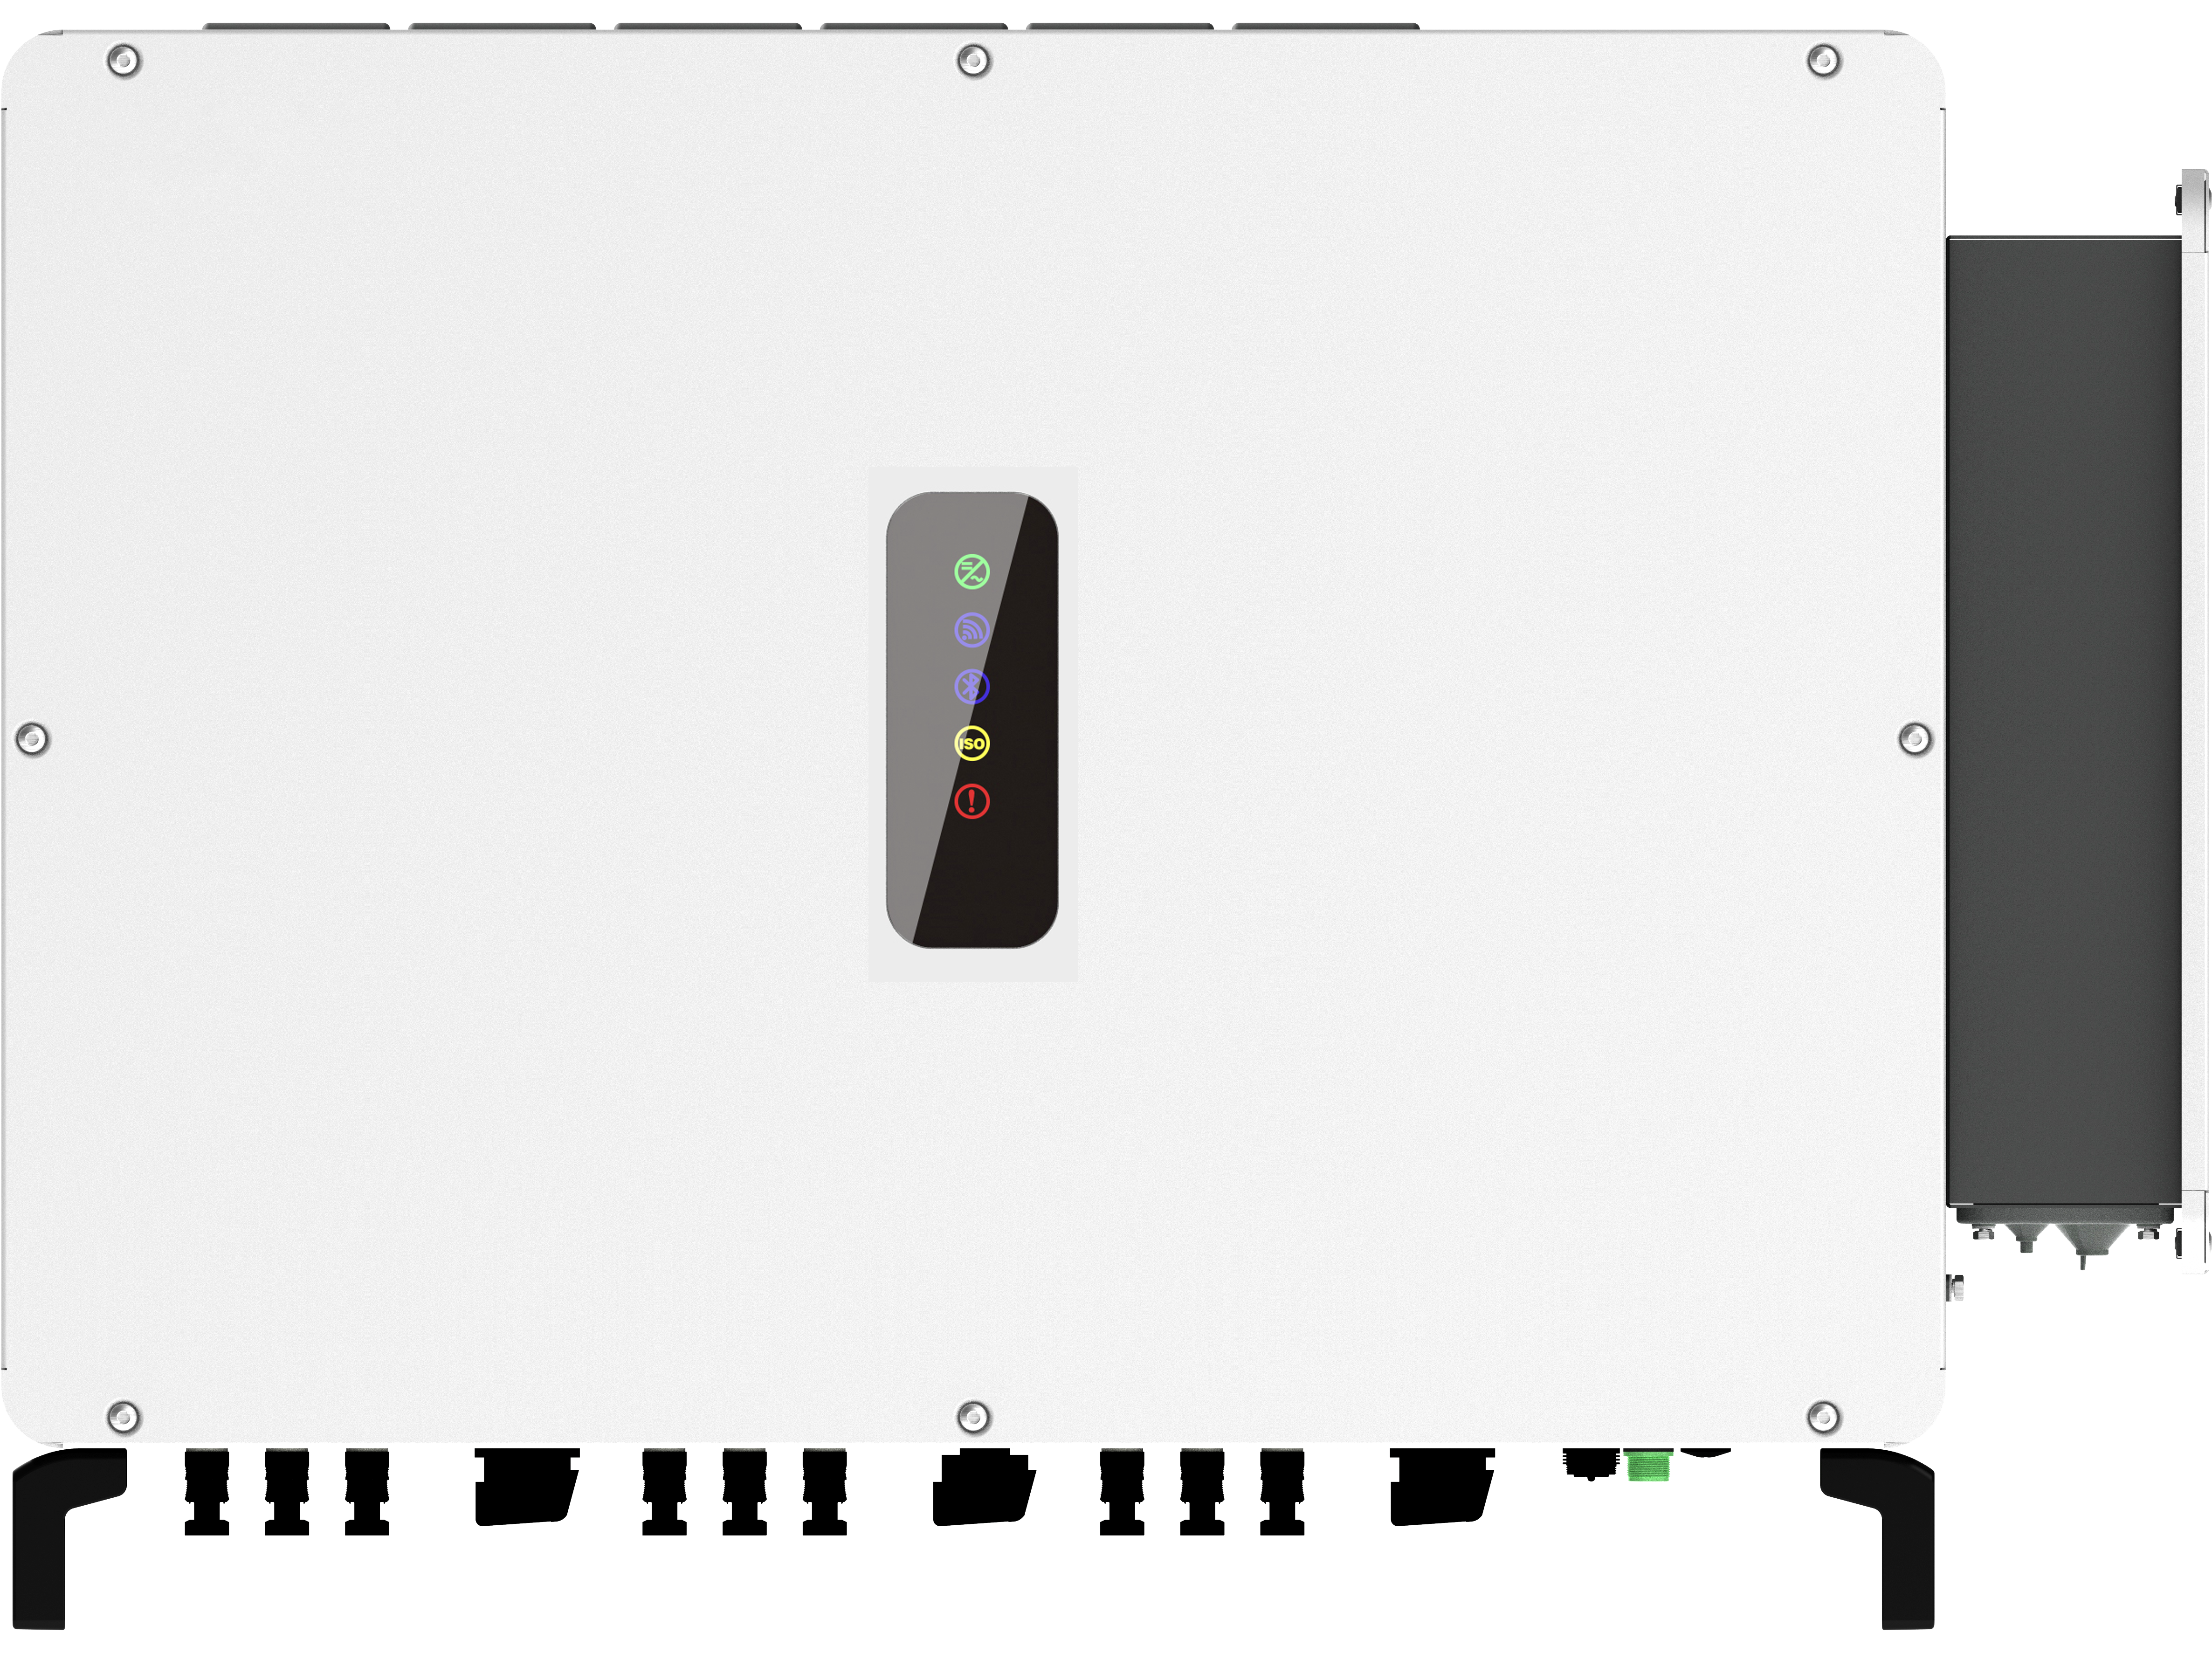
02-1 125KW ON-grid string inverter
Model | BSM125K-B
Input(DC) | Max.DC Voltage |  | 1100V
 | Max.Input Current Per MPPT |  | 40A
 | Max.Short-circuit Current Per MPPT |  | 60A
 | Start Voltage |  | 350V
 | MPPT Voltage Range |  | 200-1000V
 | Nominal Voltage |  | 650V
 | Number of MPPT | 8
 | Strings Per MPPT | 2
Output(AC) | Nominal AC Output Power | 125KW
 | Max. AC Output Power | 125kVA
 | Nominal AC Voltage | 230V/400V,3W+PE,3W+N+PE
 | AC Grid Frequency Range | 50Hz / 60Hz(±5Hz)
 | Max. Output Current | 181.2A
 | Power Factor(Φ) | 0.8leading-0.8lagging
 | THDi | ＜3%（Nominal Power）
Efficiency | Max. Efficiency | 98.7%
 | Euro Efficiency | 98.3%
 | Dimensions W x H x D | 965mm*700mm*355mm
 | Weight | 85kg

Slide 10
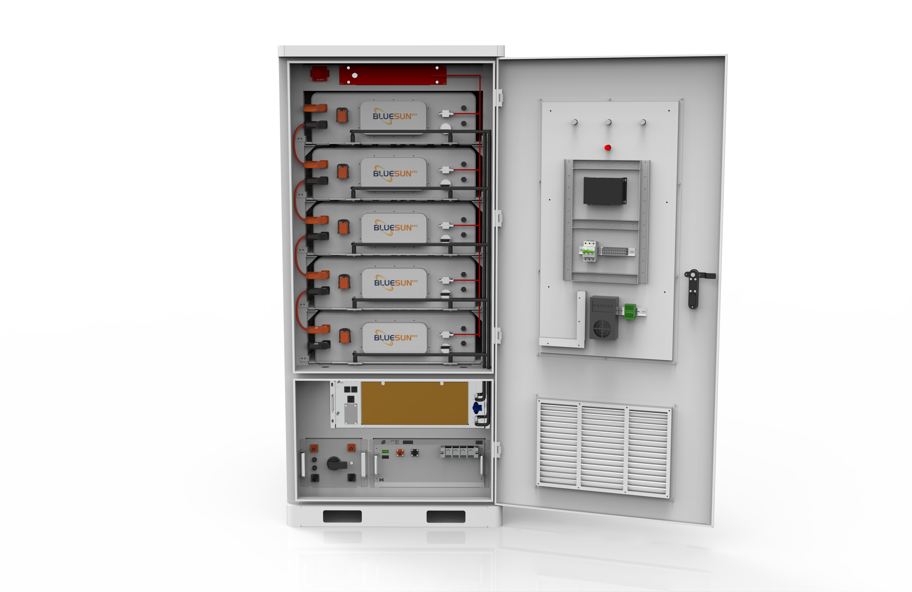
02 125KW/261KWH ENERGY STORAGE SYSTEM
125KW 261KWH ENERGY STORAGE SYSTEM
NO | Item |  | Specification
Battery Side
1 | Configuration |  | 1P260S
2 | Rated Energy |  | 261kWh
3 | Rated Voltage |  | 832VDC
4 | Voltage Range |  | 728~936VDC
5 | Charging/Discharging Current | Rated | 157A
 |  | Maximum | 314A
6 | General Parameters | Size | 1005(L)*1320(W)*2200(H)
 |  | Weight | 2.5T
 |  | IP Level | IP66
 |  | Cooling mode | Liquid Cooling
 |  | Communication agreement | CAN
 |  | Coolant | 50% Ethylene glycol aqueous solution
AC Side (Grid Connection)
Rated Voltage(V) |  | 230/400
AC Output Type |  | (3W + N + PE) three-phase four line
Rated Output Power(KW) |  | 125
Rated Grid Frequency(Hz) |  | 50/60
AC Side (off-grid)
Rated Output Voltage |  | 230/400
Rated Output Power |  | 125
Maximum Apparent Power (KW) |  | 138
Maximum Output Current (A) |  | 200
EMS
fire protection
Battery Module
Dehumidifier
Chiller
PCS
control box

Slide 11

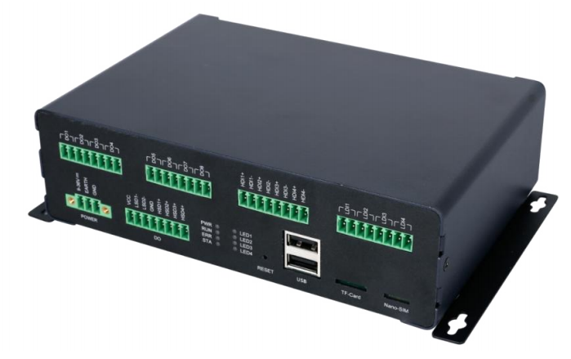
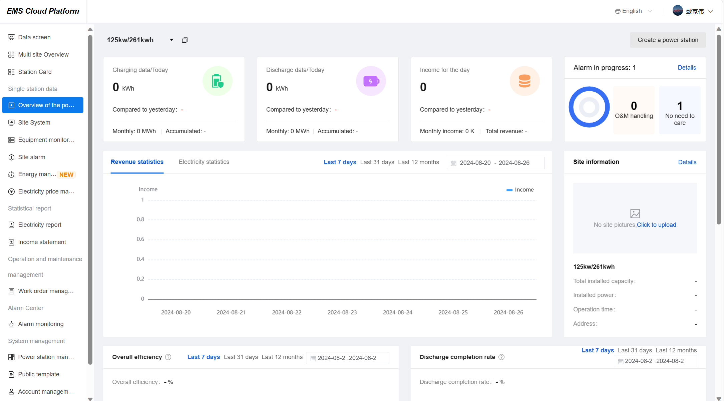
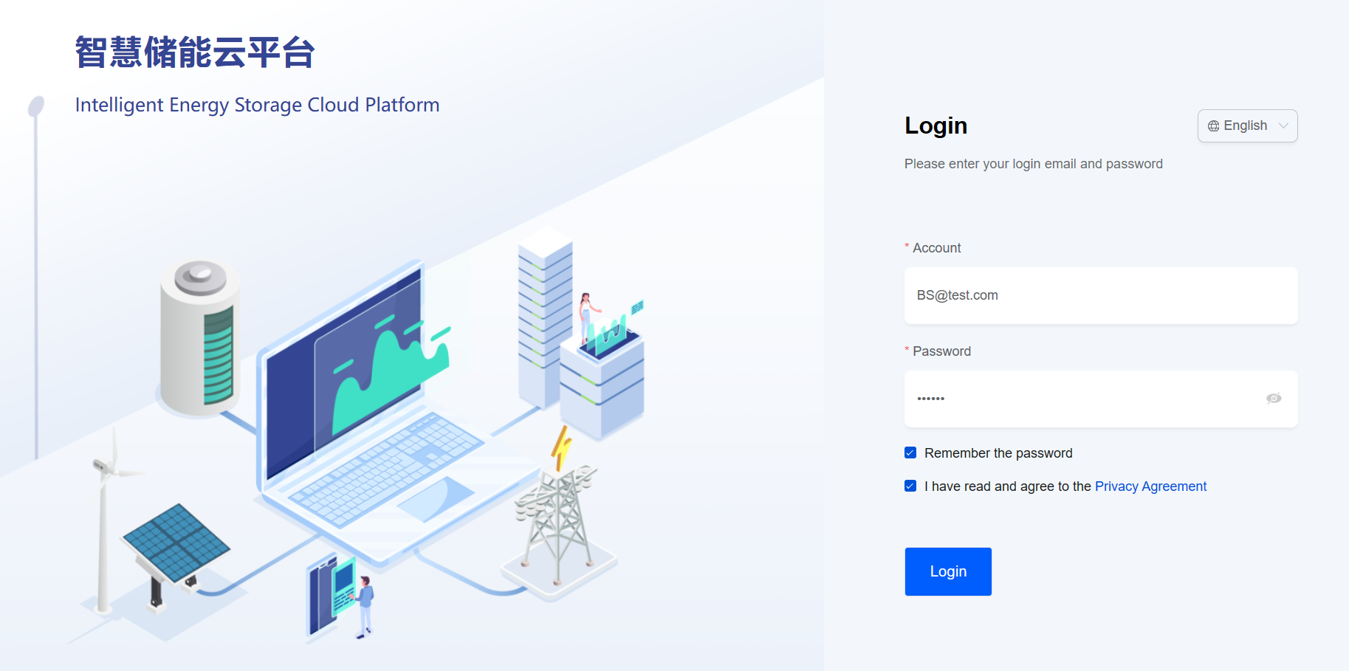
02 EMS
Input platform - the browser address: https://www.iesscloud.com/#/ can enter the login page
(it is recommended to use chrome), enter the corresponding user name and password to log in.
Testing account: BS@test.com
Password: 123456
To create a new account, the platform administrator needs to add it in [System Management]
-- [Account Settings]

Slide 12
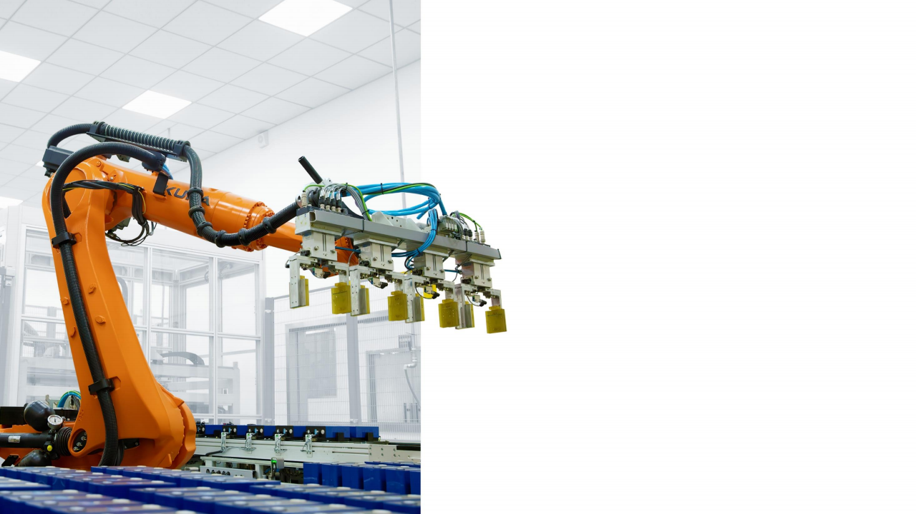
03 System Function
· PV absorption
Under the current situation, the installed capacity of photovoltaics in the region has reached saturation. During the peak period of photovoltaic power generation, it has an impact on the power grid. Therefore, it is necessary to equip with corresponding energy storage facilities to mitigate the instability of photovoltaic power generation. This set of systems can effectively absorb the electricity generated by photovoltaics during the peak period of photovoltaic power generation and supply power to users through energy storage during the peak period of electricity consumption.
· Peak Shaving and Valley Filling
The local power grid has different electricity prices corresponding to each time period. By using energy storage devices, the battery can be charged from the power grid when the electricity price is at a low stage. And when the electricity price rises to a high stage, the electricity stored in the battery can be discharged for the use of property owners. In this way, the property owners can benefit from the price difference of electricity

Slide 13


Making energy storage simple
Learn more about Bluesun
www.bluesunpv . com info@bluesunpv.com
Follow us on LinkedIn

